Slide 1
IAX0600
DIGITAL SYSTEMS DESIGN
IAX0600 DIGITAL SYSTEMS DESIGN LABS
Dmitri Mihhailov
Tallinn University of Technology
Notes:
1

Slide 2
Digital Systems Design Labs Staff
Lecturer:
Alexander Sudnitson (associate professor)
aleksander.sudnitson@taltech.ee
ICT-503 (620 2255)
Lab Assistant:
Dmitri Mihhailov
dmitri.mihhailov@taltech.ee
ICT-505 (no phone)
2
Notes:
2

Slide 3
IAX0600 Digital Systems Design Labs (1)
Lab Room:
ICT-501 (~30 working places)
Lab PCs require the same password that is used to access other computers in TTU network
Lab Time:
EAAB62
Wednesdays 16:00 - 17:30
ICT-501
IACB61, IACB62
Wednesdays 17:45 - 19:15
ICT-501
3
Notes:
3

Slide 4
IAX0600 Digital Systems Design Labs (2)
Xilinx Design Software:
Vivado Design Suite (7-Series and newer)
System Edition (in the lab)
WebPACK Edition (free)
FPGA boards:
Digilent Basys 3 (Xilinx Artix-7 FPGA)
~15 boards
used for all labs
4
Notes:
4

Slide 5
IAX0600 Digital Systems Design Labs (3)
Installing Vivado:
create Xilinx account (should be free)
be sure to have 40+ GB of free space
download installation files (Vivado 2020.1)
https://www.xilinx.com/support/download.html
select “Vivado HL WebPACK” edition
select required features:
Design Tools => Vivado Design Suite => Vivado
Devices => 7-Series => Artix 7
Installation Options => Install Cable Drivers
the complete step-by-step instruction can be found at (also available on the labs web-page):
https://reference.digilentinc.com/vivado/installing-vivado/start
5
Notes:
5

Slide 6
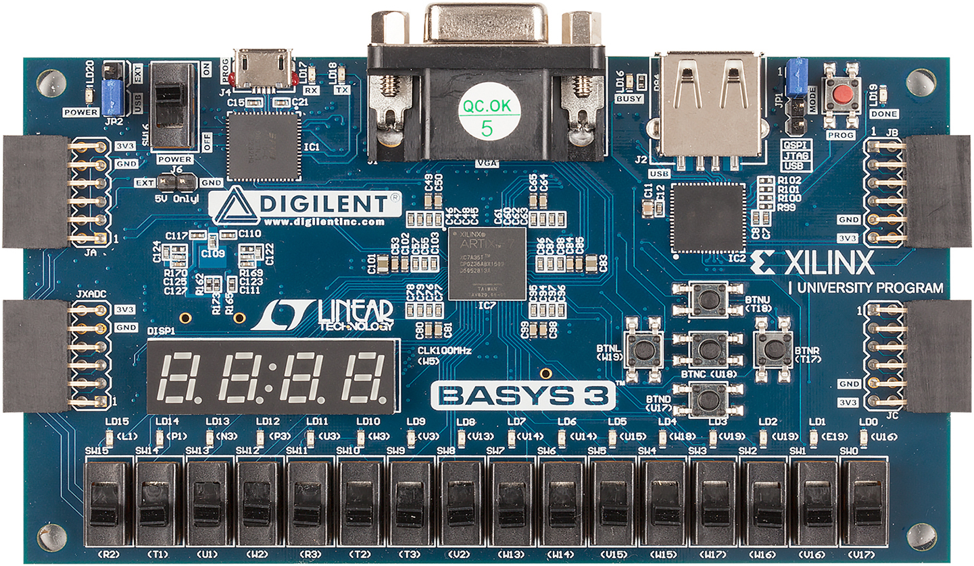
IAX0600 Digital Systems Design Labs (4)
Power Switch
PROG USB Port
6

Slide 7
IAX0600 Digital Systems Design Labs (5)
Lab Course webpage:
http://ati.ttu.ee/~alsu/
IAX0600l Digital Systems Design (WORKSHOPS)
http://ati.ttu.ee/~alsu/IAX0600l.html
Lab Syllabus
7
Notes:
7

Slide 8
IAX0600 Digital Systems Design Labs (6)
Tutorial:
Basic Vivado Tutorial : Part 1
Basic Vivado Tutorial : Part 2
Regular Labs:
Lab 1 : Logic Gates +5 points
Lab 2 : Combinational Logic +10 points
requires submission of the report
Lab 3 : Structural Design +10 points
Lab 4 : Sequential Logic +15 points
Lab 5 : Creeping Line Project +20 points
requires submission of the report
All labs give 60 points in total
8
Notes:
8

Slide 9
LABS Schedule
Tutorial labs:
Week 3 (10.02.2021) : Tutorial 1
Week 3 (10.02.2021) : Tutorial 2
Labs (first half):
Week 4 (17.02.2021) : Lab 1
Week 6 (03.03.2021) : Lab 2
Week 8 (17.03.2021) : Lab 3
+ 5 points if passed until 30.03.2021 (Bonus 1)
Labs (second half):
Week 10 (31.03.2021) : Lab 4
Week 13 (21.04.2021) : Lab 5
+ 5 points if passed until 14.05.2021 (Bonus 2)
9
Notes:
9

Slide 10
List of General Lab Requirements
General lab requirements:
The deadline is 16th week (14.05.2020)
Labs are done INDIVIDUALLY
Labs are passed in the same order as they are listed on the webpage
If the lab is broken into several steps, then each step requires a separate visual demonstration
Functional simulation MUST always be performed
For all questions/problems regarding the lab course, please, get in touch with the lab staff
Some lab manuals feature TASK description and EXAMPLE solution of a similar task
10
Notes:
10

Slide 11
How to Pass a Lab
Step 1 (Visual Demonstration):
Working prototype is examined for functional correctness during lab session
Step 2 (Lab Submission):
Submit to dmitri.mihhailov@taltech.ee (cc: aleksander.sudnitson@taltech.ee):
Lab report (PDF) (Labs 2 and 5 only)
Project archive
Wait for acknowledgment of acceptance
Step 3 (Defense):
Answer questions regarding report and sources
Be ready to answer ANY general questions
11
Notes:
11

Slide 12
How to Write a Report (1)
Reports are written in FREE form
The goals of lab report:
Document the workflow
Describe the results and their significance
Demonstrate writer’s comprehension
List of topics to cover in the report:
Introduction
Background
Workflow
Results and discussion
Conclusion (including feedback)
References and appendices
12
Notes:
12

Slide 13
How to Write a Report (2)
In is highly advised to start working on the reports BEFORE the lab
Prepare before the lab:
Introduction
Background and References
Workflow (part that can be done before the lab)
Prepare during the lab:
Workflow (remaining part)
Prepare after the lab:
Results and discussion
Conclusion
13
Notes:
13

Slide 14
List of General Report Requirements
General report requirements:
Lab report MUST feature things that are specifically required to be included in the task
All objects in the text MUST be numbered, labeled and referenced
All figures, tables, code listings, statements, results MUST be explicitly explained within text
Complete source codes MUST NOT be part of the report (even in appendices)
All materials taken from external sources MUST be referenced (also within the text)
Functional simulation MUST always be described
14
Notes:
14

