Slide 1

LAB 2 – Router Design
IAS0630 Hardware Security SPRING, 2026.
Sharjeel Imtiaz Email: sharjeel.imtiaz@taltech.ee
Centre for Dependable Computing Systems
Dpt. of Computer Systems - School of IT
Tallinn University of Technology
Notes:
Started in dec.

Slide 2
Lab 2 Overview
Objectives:
Understand packet-based data transfer on a fixed-width bus
Implement a simple router using sequential logic
Accumulate and forward packets based on protocol rules
Analyze timing behavior using simulation and waveforms
Tools Used:
Linux Terminal
Cadence Xcelium (xrun)
Verilog HDL
Required Environment:
Linux OS (lab PCs are dual-boot)
TalTech credentials for login
Terminal access
Important Notes:
If the machine boots into Windows, restart and select Linux
All work should be done inside your home directory
All Lab Files
Index of /~spagliar/teaching/ias0630/labs

Slide 3
Basic Linux Setup
Open a terminal and type.
cd ~
mkdir work
cd work
Load Cadence tools:
Type Cad
Select option 1 – Cadence
Download sample design:
wget https://ati.ttu.ee/~spagliar/teaching/ias0630/labs/sample.v
Run simulation:
xrun sample.v
Expected Output:
IAS0630 FSM SAMPLE
Simulation complete via finish.
Simulate with GUI:
xrun -gui -debug sample.v
You should observe:
A waveform window &A counter counting from 32 down to 0

Slide 4
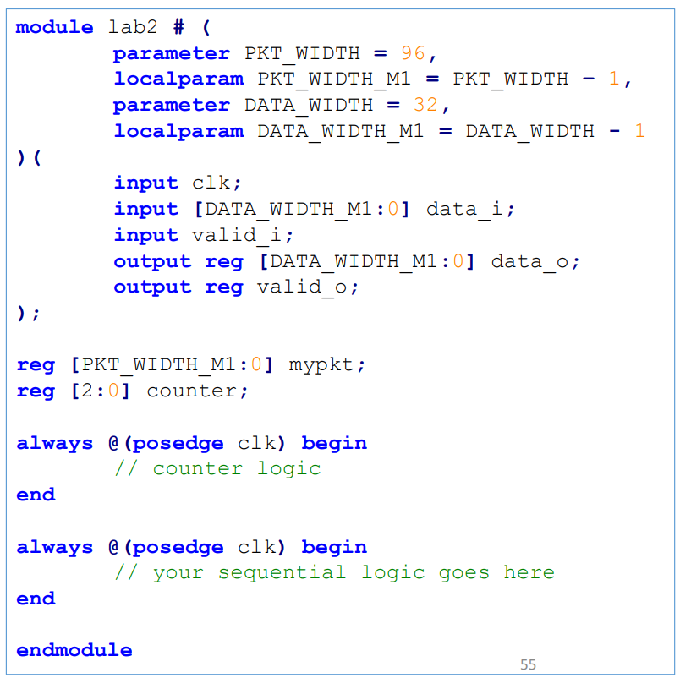
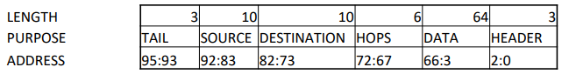
Lab Description
Task:
Design a router module that receives packets over a 32-bit input bus, reconstructs the packet internally, and forwards it according to given constraints.
Router Features:
Packet size: 96 bits
Input/output bus width: 32 bits
Packets transferred in 4 cycles in, 4 cycles out
Sequential design using clocked logic
Packet Structure
Important:
Packets travel on a 32-bit bus
You must accumulate incoming data before transmission
Check lab2_tb.v to understand exact bit ordering

Slide 5
Functional & Timing Constraints
valid_i must be asserted one clock cycle before valid data
valid_i must be deasserted with the last data word
Total operation time: 8 clock cycles
4 cycles for receiving
4 cycles for transmitting
No idle cycles between receive and transmit
Implementation Constraints:
Use one 96-bit internal register
Use one 3-bit counter
Use two always @(posedge clk) blocks

Slide 6
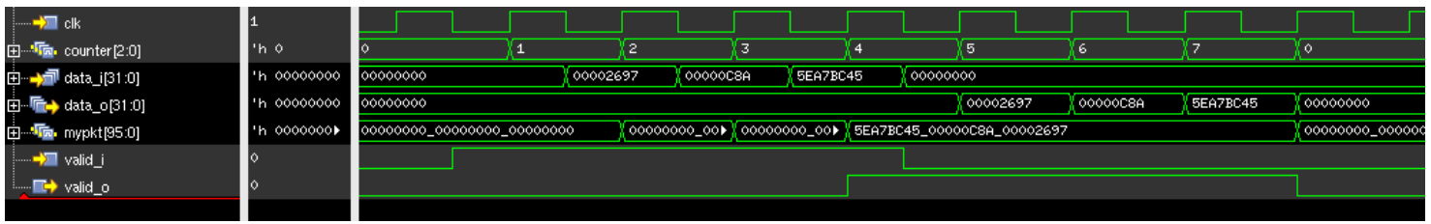
Expected waveform

Slide 7
Routing Rules & Packet Filtering
Packet Handling Rules:
Increment hops by 1 for every transmitted packet
Do not forward packet if:
Header ≠ 3’b101
Tail ≠ 3’b010
Hops > 6’d10
Additional Requirements:
Use a third always @(*) block
Print a message on the terminal when a packet is dropped
Message must appear in the same cycle the condition is detected
Verification
Use waveform viewer to verify:
Counter operation
Packet accumulation
Output timing and validity signals
Expected waveform is provided
Refer to lab2_tb.v to understand stimulus behavior

Slide 8
Deliverables
Submit a zip file named:
Lab2_StudentID.zip
Zip file should contain.
Verilog module file (lab2.v)
Screenshot of successful simulation
Waveform screenshot showing correct behavior
Brief description of router working flow (in your own words)

Slide 9
Thank you!

