Slide 1

LAB 7 - FSM Obfuscation (Logic Locking)
IAS0630 Hardware Security SPRING, 2026.
Sharjeel Imtiaz
Email: sharjeel.imtiaz@taltech.ee
Centre for Dependable Computing Systems
Dpt. of Computer Systems - School of IT
Tallinn University of Technology
Notes:
Started in dec.

Slide 2
Lab 6 Overview
Objectives:
  Understand FSM obfuscation as a hardware security technique
  Protect an existing FSM using a lock/unlock mechanism
  Prevent unauthorized access to original functionality
  Verify correct and incorrect unlocking through simulation
Tools Used:
  Linux Terminal
  Cadence Xcelium (xrun -gui)
  Verilog HDL
Required Environment:
  Linux OS (lab PCs are dual-boot)
  TalTech credentials for login
  Terminal access
Important Notes:
  If the machine boots into Windows, restart and select Linux
  All work should be done inside your home directory
All Lab Files
  Index of /~spagliar/teaching/ias0630/labs

Slide 3
Basic Linux Setup
Open a terminal and type.
  cd ~
  mkdir work
  cd work
Load Cadence tools:
  Type Cad
  Select option 1 – Cadence
Download sample design:
  wget https://ati.ttu.ee/~spagliar/teaching/ias0630/labs/sample.v
Run simulation:
  xrun sample.v
Expected Output:
  IAS0630 FSM SAMPLE
  Simulation complete via finish.
Simulate with GUI:
  xrun -gui -debug sample.v
You should observe:
  A waveform window &A counter counting from 32 down to 0

Slide 4
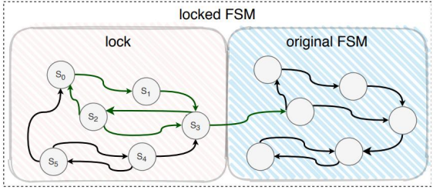
Lab Description
Task:
  Apply FSM obfuscation to the FSM designed in Lab 3 by adding a lock sequence that must be correctly executed before the original FSM becomes accessible.
Starting Point:
  Use the FSM solution from Lab 3 as the original FSM
  The original functionality must remain inaccessible until unlocked
Lock FSM Requirements:
  Add 4 new states before the original FSM:
    ST_OBF0, ST_OBF1, ST_OBF2, ST_OBF3
  Use valid_i as the control signal
  Correct unlock sequence:
    0 → 1 → 1 → 0
Security Rules:
Any incorrect sequence must:
  Be rejected immediately
  Force the FSM back to ST_OBF0
The original FSM must not be reachable otherwise

Slide 5
Functional , Implementation Constraints & Verification
Functional & Implementation Constraints
  Original FSM logic must remain unchanged
  Obfuscation logic must be integrated into the FSM control flow
  Unlocking must occur only once per reset
  FSM must clearly separate:
    Locked region
    Original FSM region
Verification Requirements:
Improve the Lab 3 testbench to:
  Test correct unlocking sequence
  Test incorrect unlocking attempts
Demonstrate that:
  Correct sequence unlocks functionality
  Incorrect sequences never reach original FSM
Waveform Verification:
Show transitions through ST_OBF* states
Show entry into original FSM only after correct unlock

Slide 6
Deliverables
Submit a zip file named:
  Lab7_StudentID.zip
Zip file should contain.
  Modified FSM Verilog file
  Updated testbench file
  Screenshot of successful simulation
  Waveform screenshot showing:
    Lock sequence
    Rejection of incorrect sequence
    Entry into original FSM
  Brief explanation of:
    Obfuscation strategy
    Security benefit of FSM locking

Slide 7
Thank you!

