Slide 1

LAB 3 – Finite State Machines (FSM)
IAS0630 Hardware Security SPRING, 2026.
Sharjeel Imtiaz
Email: sharjeel.imtiaz@taltech.ee
Centre for Dependable Computing Systems
Dpt. of Computer Systems - School of IT
Tallinn University of Technology
Notes:
Started in dec.

Slide 2
Lab 3 Overview
Objectives:
  Understand and implement Finite State Machines (FSMs) in Verilog
  Design a sequential hash function using FSM-based control
  Handle overflow conditions using state transitions
  Verify FSM behavior using simulation and waveform analysis
Tools Used:
  Linux Terminal
  Cadence Xcelium (xrun)
  Verilog HDL
Required Environment:
  Linux OS (lab PCs are dual-boot)
  TalTech credentials for login
  Terminal access
Important Notes:
  If the machine boots into Windows, restart and select Linux
  All work should be done inside your home directory
All Lab Files
  Index of /~spagliar/teaching/ias0630/labs

Slide 3
Basic Linux Setup
Open a terminal and type.
  cd ~
  mkdir work
  cd work
Load Cadence tools:
  Type Cad
  Select option 1 – Cadence
Download sample design:
  wget https://ati.ttu.ee/~spagliar/teaching/ias0630/labs/sample.v
Run simulation:
  xrun sample.v
Expected Output:
  IAS0630 FSM SAMPLE
  Simulation complete via finish.
Simulate with GUI:
  xrun -gui -debug sample.v
You should observe:
  A waveform window &A counter counting from 32 down to 0

Slide 4
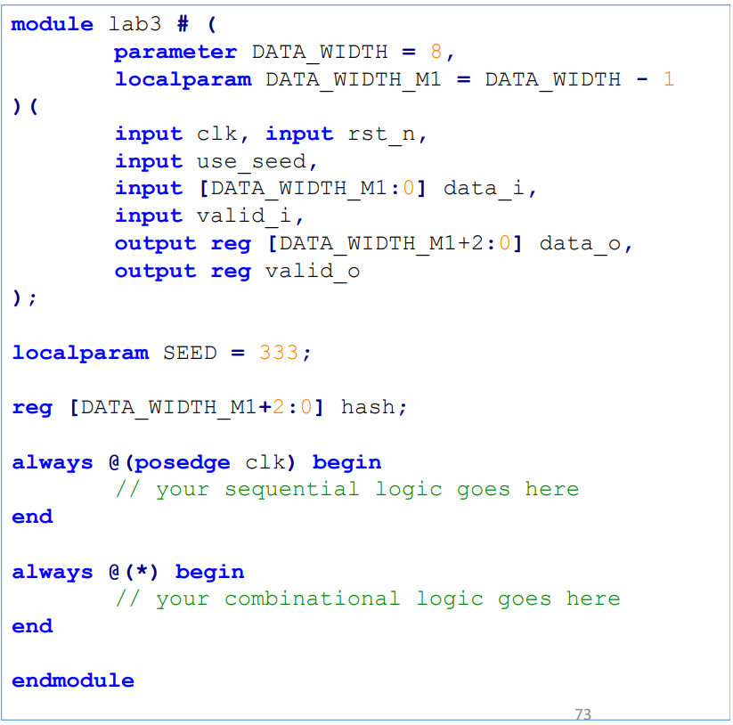
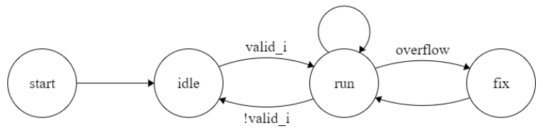
Lab Description
Task:
  Design an FSM-based circuit that computes a simple hash function over sequential input data.
Hash Function:
  Used for signature generation or reduction
  Fix operation:
    hash = (hash mod 997) + 7
A testbench is provided in lab3_tb.v

Slide 5
Inputs and Outputs
Inputs:
  clk – system clock
  rst_n – asynchronous active-low reset
  use_seed – selects initial hash value
  data_i (8-bit) – input data
  valid_i – indicates valid input data
Outputs:
  data_o – hash output
  valid_o – indicates valid hash output
Initial Hash Value:
  333 if use_seed = 1
  0 if use_seed = 0

Slide 6
FSM Functional Rules
On every clock cycle:
  If valid_i = 1, input data is processed
If no overflow occurs:
  data_i is added to current hash
  valid_o is asserted
If overflow occurs:
  Addition still happens
  valid_o is deasserted immediately
  One clock cycle is spent in a fix state
Fix Operation:
hash = (hash mod 997) + 7

Slide 7
FSM Constraints
Must use 2-always block FSM template
  One sequential block
  One combinational block
Reset must be asynchronous and active-low
FSM must contain 4 states:
  start
  idle
  run
  fix
State transitions must follow the given FSM diagram.

Slide 8
Verification & Part 2 Task
Verification:
  Expected waveform is provided
  Use waveform viewer to verify:
    State transitions
    Hash updates
    Overflow and fix behavior
Part 2 – Collision Analysis:
  Modify the testbench to create a hash collision
  A collision occurs when:
    Two different input sequences produce the same hash
  Use:
    Long input sequences
    Reset between hash operations

Slide 9
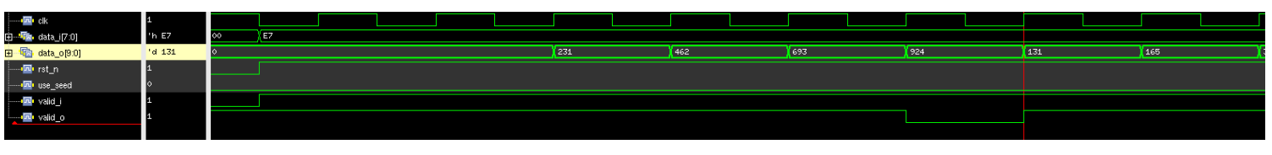
Expected waveform
Assume inputs are 8’d231 (8’hE7)

Slide 10
Deliverables
Submit a zip file named:
  Lab3_StudentID.zip
Zip file should contain.
  Verilog module file (lab3.v)
  Screenshot of successful simulation
  Waveform screenshot showing correct behavior
  Brief description of router working flow (in your own words)

Slide 11
Thank you!

