Slide 1

LAB 4 – AES Simulation
IAS0630 Hardware Security SPRING, 2026.
Sharjeel Imtiaz Email: sharjeel.imtiaz@taltech.ee
Centre for Dependable Computing Systems
Dpt. of Computer Systems - School of IT
Tallinn University of Technology
Notes:
Started in dec.

Slide 2
Lab 4 Overview
Objectives:
Learn to simulate an AES cipher core in Verilog
Write a testbench to perform multiple encryptions under the same key
Analyze timing, confusion and diffusion properties via simulation
Tools Used:
Linux Terminal
Cadence Xcelium (xrun)
Verilog HDL
Required Environment:
Linux OS (lab PCs are dual-boot)
TalTech credentials for login
Terminal access
Important Notes:
If the machine boots into Windows, restart and select Linux
All work should be done inside your home directory
All Lab Files
Index of /~spagliar/teaching/ias0630/labs

Slide 3
Basic Linux Setup
Open a terminal and type.
cd ~
mkdir work
cd work
Load Cadence tools:
Type Cad
Select option 1 – Cadence
Download sample design:
wget https://ati.ttu.ee/~spagliar/teaching/ias0630/labs/sample.v
Run simulation:
xrun sample.v
Expected Output:
IAS0630 FSM SAMPLE
Simulation complete via finish.
Simulate with GUI:
xrun -gui -debug sample.v
You should observe:
A waveform window &A counter counting from 32 down to 0

Slide 4
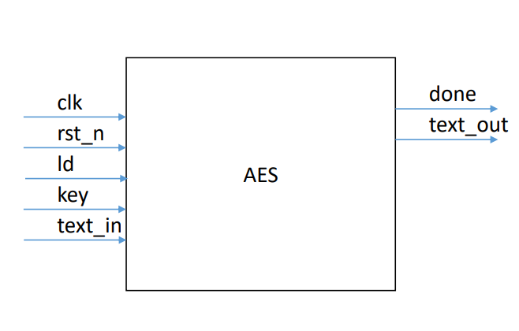
Lab Description
Task:
Write a testbench that encrypts 5 different plaintexts using the same AES key.
For each plaintext, observe done and capture text_out.
Verify the results using an external AES calculator (suggested: the AES calculator referenced in class).
Questions to answer in your brief report:
How many cycles does each encryption take?
Does computation time depend on key or plaintext?
Can you demonstrate confusion? (show differing outputs for small key/plaintext changes)
Can you demonstrate diffusion? (small plaintext change affects many output bits)
Source code (starter): aes.zip (top-level aes_cipher_top.v). See lab sources

Slide 5
Module Interface & Signals
Top-level signals (aes_cipher_top.v):
clk — clock
rst_n — asynchronous active-low reset
ld — load: 1 to load key/text, 0 to perform computation
key — key input (bus width per top module)
text_in — plaintext input
done — indicates encryption finished
text_out — cipher output
Notes:
ld = 1 indicates loading inputs; ld = 0 starts computation.

Slide 6
Activity Instructions
Unzip aes.zip into your working folder and open aes_cipher_top.v.
Create a testbench lab4_tb.v that:
Applies reset, then releases it.
Loads a single key (same key for all tests).
For each of 5 plaintexts:
Assert ld = 1 and present key and text_in for the required cycles to load.
Deassert ld (set ld = 0) to start computation.
Wait for done to assert; record text_out and cycle count.
Insert a small gap or reset between tests if needed.
Print runtime info (start cycle, done cycle, cycles taken, text_out).
Verify each text_out against an AES reference (web calculator or trusted tool).
Produce waveform screenshots showing ld, done, text_in, text_out, and key lines.

Slide 7
Functional Requirements & Verification
Functional Requirements:
Testbench must preserve a single fixed key across all 5 encryptions
For each test: measure cycles from start (ld release) to done assertion
Do not modify core source files; only add a testbench
Ensure reset is asserted initially and is released before test vectors
Verification:
Verify outputs using the online AES calculator (or a reference AES tool)
Show waveforms for at least two tests (one demonstrating typical run, one demonstrating any observable latency or behavior)
Answer confusion/diffusion questions with concrete examples (e.g., flip 1 bit of plaintext → show output bits changed)

Slide 8
Deliverables
Submit a zip file named:
Lab4_StudentID.zip
Zip file should contain.
Testbench file lab4_tb.v
Any small scripts you used to generate vectors (optional)
Screenshots:
Waveform showing ld, done, text_in, text_out
Screenshot showing verification result from AES calculator for at least two plaintexts
Short report (1 page max) containing:
Key used, list of 5 plaintexts and corresponding ciphertexts
Cycles taken for each encryption
Answers to confusion/diffusion questions

Slide 9
Thank you!

