Slide 1

LAB 5 – Multi-Round Caesar Cipher
IAS0630 Hardware Security SPRING, 2026.
Sharjeel Imtiaz Email: sharjeel.imtiaz@taltech.ee
Centre for Dependable Computing Systems
Dpt. of Computer Systems - School of IT
Tallinn University of Technology
Notes:
Started in dec.

Slide 2
Lab 5 Overview
Objectives:
Implement a multi-round Caesar-like cipher in Verilog
Use FSM-based control for multi-cycle computation
Understand key scheduling and round-based encryption
Verify encryption timing and correctness using simulation
Tools Used:
Linux Terminal
Cadence Xcelium (xrun -gui)
Verilog HDL
Required Environment:
Linux OS (lab PCs are dual-boot)
TalTech credentials for login
Terminal access
Important Notes:
If the machine boots into Windows, restart and select Linux
All work should be done inside your home directory
All Lab Files
Index of /~spagliar/teaching/ias0630/labs

Slide 3
Basic Linux Setup
Open a terminal and type.
cd ~
mkdir work
cd work
Load Cadence tools:
Type Cad
Select option 1 – Cadence
Download sample design:
wget https://ati.ttu.ee/~spagliar/teaching/ias0630/labs/sample.v
Run simulation:
xrun sample.v
Expected Output:
IAS0630 FSM SAMPLE
Simulation complete via finish.
Simulate with GUI:
xrun -gui -debug sample.v
You should observe:
A waveform window &A counter counting from 32 down to 0

Slide 4
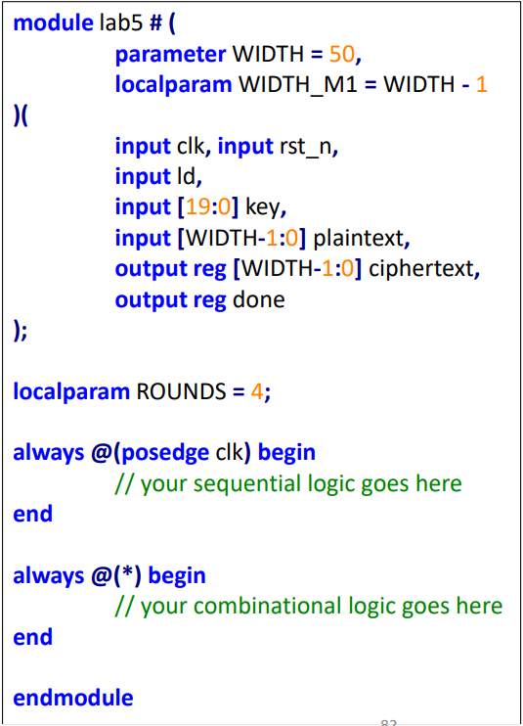
Lab Description
Task:
Design a multi-round Caesar-like cipher that encrypts a fixed-length plaintext using a round-dependent key schedule.
Cipher Properties:
Number of rounds: 4 (fixed)
Plaintext length: 10 symbols
Each symbol width: 5 bits
Total plaintext width: 50 bits

Slide 5
Key Schedule & Inputs
Key Schedule:
Key width: 20 bits
5 bits per round
key[4:0] → Round 1 shift
key[9:5] → Round 2 shift
key[14:10] → Round 3 shift
key[19:15] → Round 4 shift
Inputs:
clk – system clock
rst_n – asynchronous active-low reset
ld – indicates inputs are ready to be loaded
key – round key schedule
plaintext – input text
Outputs:
ciphertext – encrypted output
done – asserted for one clock cycle only

Slide 6
Functional, Timing Constraints & Guidlines
Must use an FSM (refer to Lab 3)
Entire computation (from ld to done) takes exactly 5 clock cycles
Inputs must be stored internally when ld = 1
done must be asserted for one cycle only
After being done, the design must be ready for new data
Suggested FSM States:
IDLE – wait for ld
LOAD – store plaintext and key
ROUND – perform 4 Caesar rounds
DONE – assert done for one cycle
Implementation Rules:
Use 2-always FSM template
Sequential block for state and registers
Combinational block for next-state logic
Cipher shifts are applied round-by-round

Slide 7
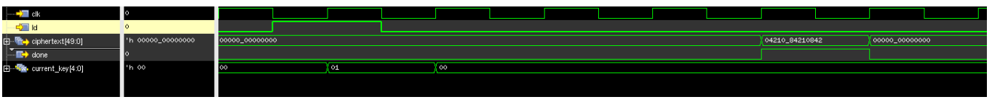
Verification
Expected waveform is provided
Use Xcelium GUI to observe:
FSM state transitions
Round counter
Ciphertext updates
done pulse timing
Refer to lab5_tb.v to understand stimulus behavior and timing.

Slide 8
Deliverables
Submit a zip file named:
Lab5_StudentID.zip
Zip file should contain.
Verilog module file (lab5.v)
Screenshot of successful simulation
Waveform screenshot showing:
ld, ciphertext, done
Brief explanation of:
FSM operation
Round-based encryption flow

Slide 9
Thank you!

