Slide 1

LAB 1 – ALU and Tool Introduction
IAS0630 Hardware Security SPRING, 2026.
Sharjeel Imtiaz Email: sharjeel.imtiaz@taltech.ee
Centre for Dependable Computing Systems
Dpt. of Computer Systems - School of IT
Tallinn University of Technology
Notes:
Started in dec.

Slide 2
Lab 1 Overview
Objectives:
Become familiar with the Linux-based lab environment
Learn how to compile and simulate Verilog designs
Use Xcelium simulator and waveform viewer
Implement a simple ALU in Verilog
Tools Used:
Linux Terminal
Cadence Xcelium (xrun)
Verilog HDL
Required Environment:
Linux OS (lab PCs are dual-boot)
TalTech credentials for login
Terminal access
Important Notes:
If the machine boots into Windows, restart and select Linux
All work should be done inside your home directory
All Lab Files
Index of /~spagliar/teaching/ias0630/labs

Slide 3
Basic Linux Setup
Open a terminal and type.
cd ~
mkdir work
cd work
Load Cadence tools:
Type Cad
Select option 1 – Cadence
Download sample design:
wget https://ati.ttu.ee/~spagliar/teaching/ias0630/labs/sample.v
Run simulation:
xrun sample.v
Expected Output:
IAS0630 FSM SAMPLE
Simulation complete via finish.
Simulate with GUI:
xrun -gui -debug sample.v
You should observe:
A waveform window &A counter counting from 32 down to 0

Slide 4
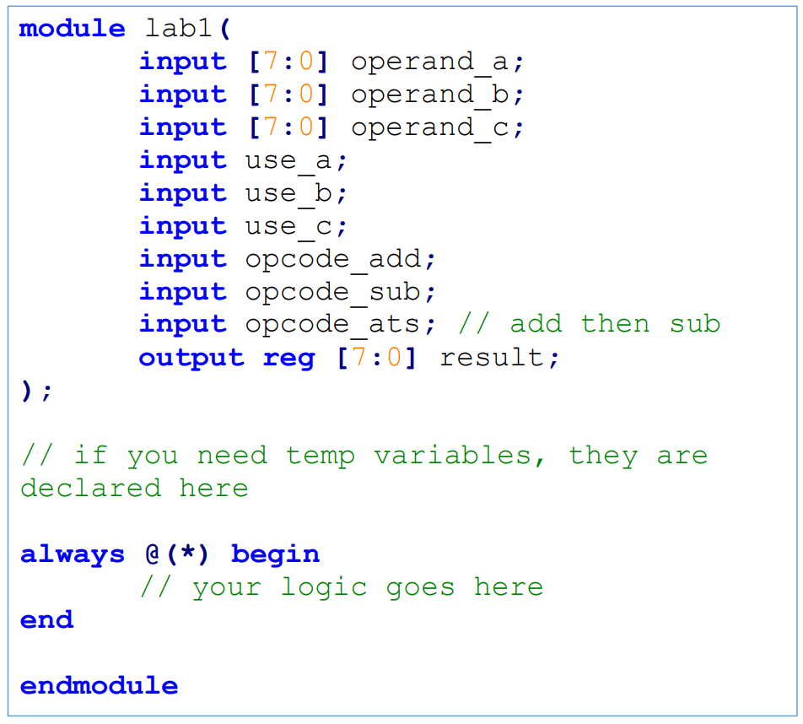
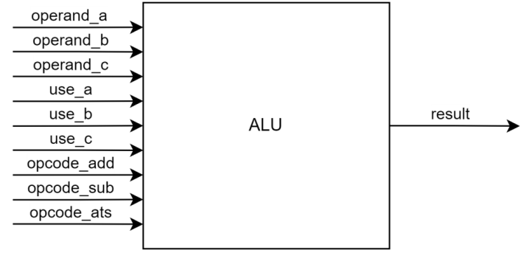
ALU Lab Description
Task:
Design a combinational ALU using Verilog.
ALU Features:
3 operands (8-bit each)
3 operations
ADD: add 2 inputs
SUB: subtract 2 inputs
ATS: add 2 inputs, sub the third
Controlled using opcode and enable signals.

Slide 5
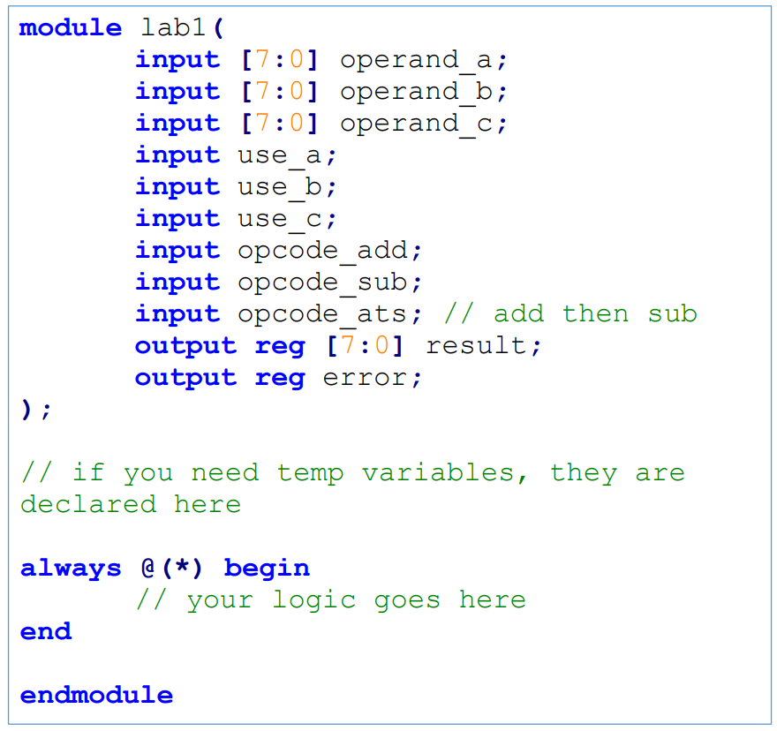
ALU Lab Description
Inputs:
operand_a, operand_b, operand_c (8-bit)
use_a, use_b, use_c (operand enable signals)
opcode_add
opcode_sub
opcode_ats (add then subtract)
Outputs:
result (8-bit)
error (1-bit)

Slide 6
Operation Rules (Very Important)
Exactly one opcode must be active at a time.
Operand requirements:
ADD → exactly 2 operands enabled
SUB → exactly 2 operands enabled
ATS → exactly 3 operands enabled
If rules are violated → error = 1
Error triggers when the number of used inputs does not match the number of operators for the given opcode.
A testbench is provided in lab1_tb.v for your reference; you can modify it accordingly.

Slide 7
Deliverables
Submit in zip files and the name of the zip file should be
Lab1_StudentID.zip
Zip file should contain.
Verilog module file (lab1.v)
Screenshot of successful simulation
Waveform screenshot showing correct behavior
A brief working flow of ALU design in your observation.

Slide 8
Thank you!

